Slide 1
Meeting Week 17
Last week summary
Parameter recovery – adding parameters together
Augmentation
  Planning
  Additional state
Outline ToDo next week

Slide 2
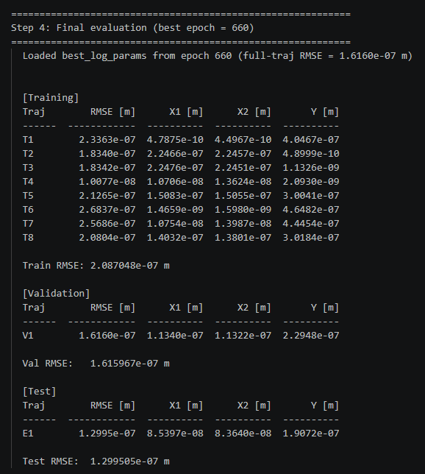
Trajectory – parameter recovery
Out of 1500 epochs, best validation RMSE for epoch 660

Slide 3
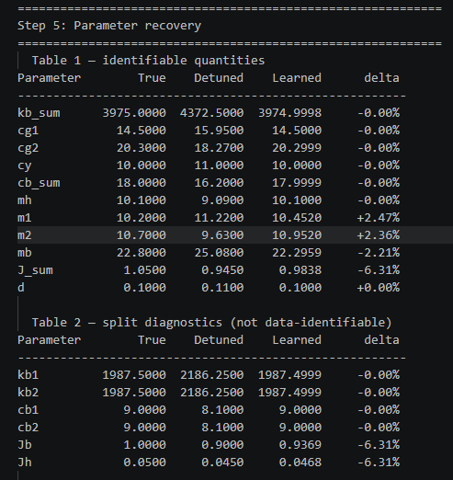
Trajectory – parameter recovery
Mainly J_sum
m1, m2 and mb

Slide 4
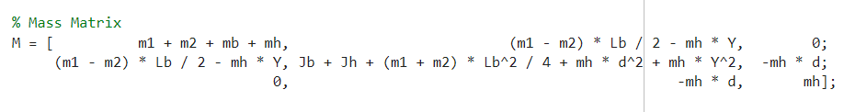
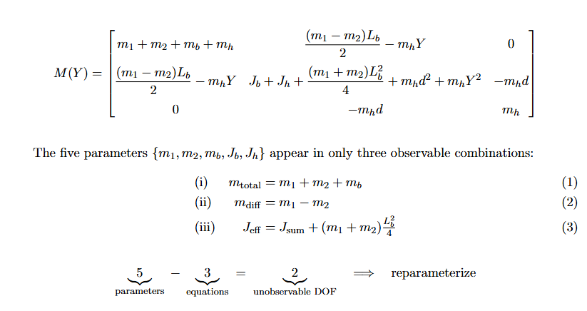

Trajectory – parameter recovery
If we sum the matrix indexes they match the true parameters exactly
But current problem: the individual parameters cannot be identified

Slide 6
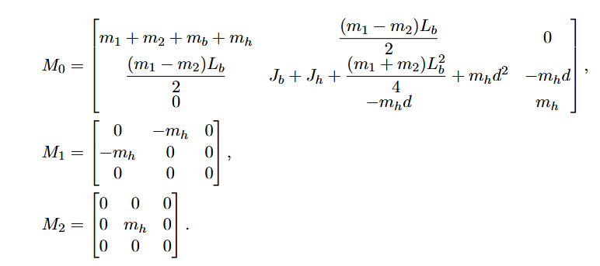
Print additional table for each matrix index

Slide 7
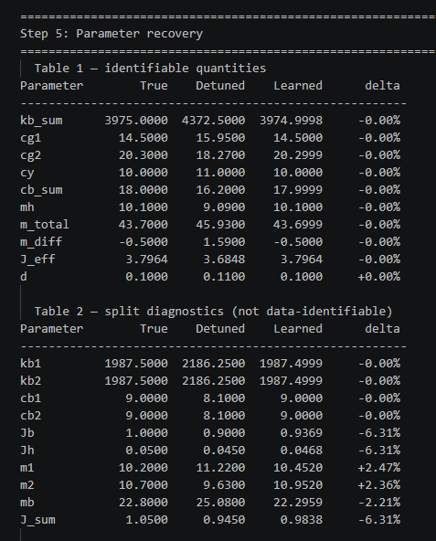
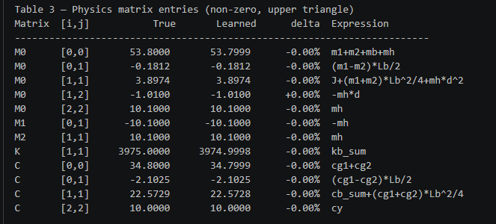

Slide 8
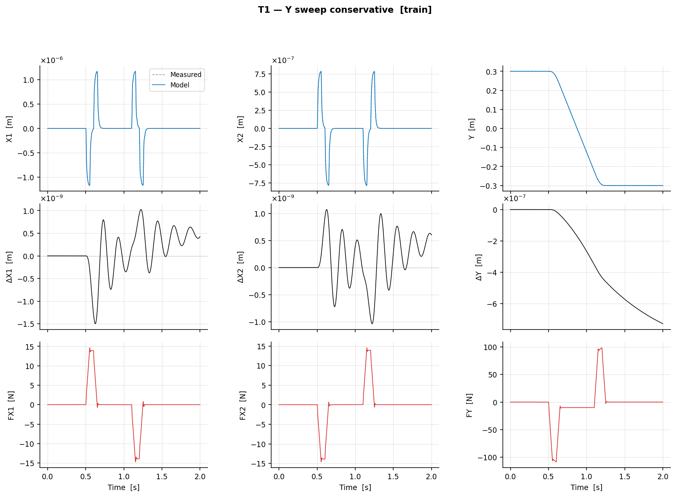
T1 – Y sweep conservative (training set)

Slide 9
Trajectories + multisine
Without multisine perfect recovery
  No reason to continue with multisine at the moment
Instead need to move on to augmenation

Slide 10
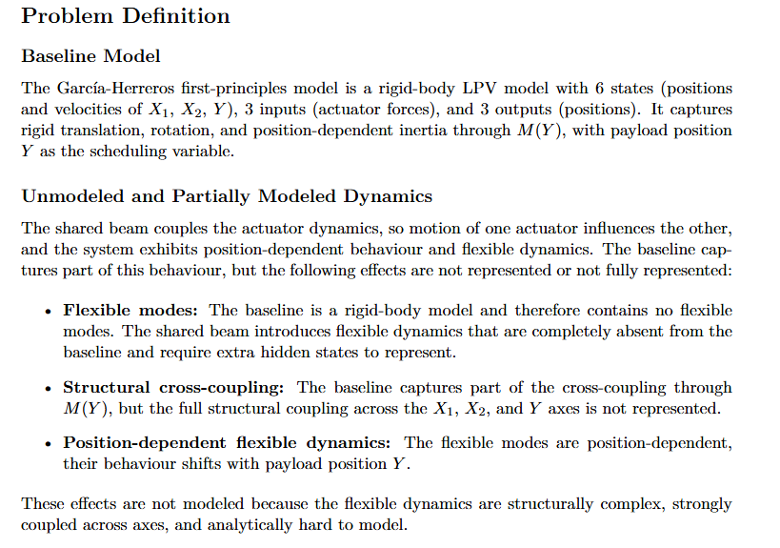

Slide 11
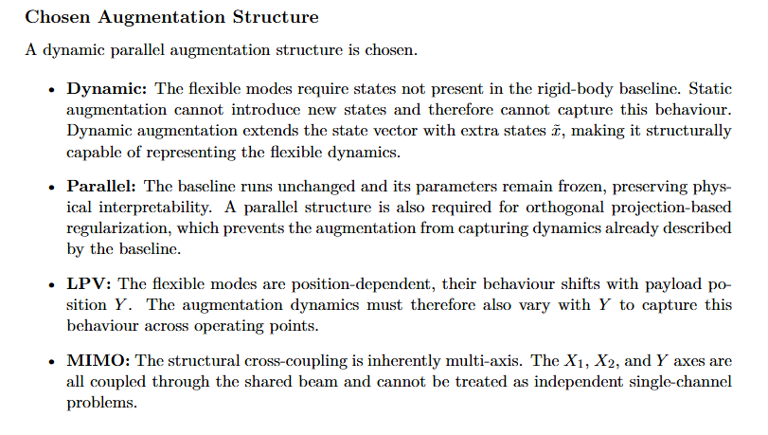

Slide 12
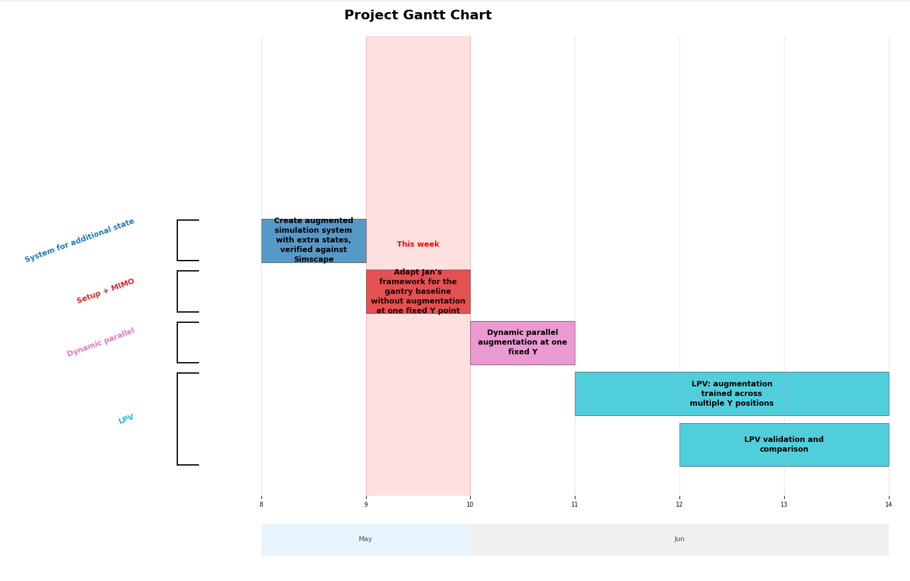

Slide 13
Augmentation
Adding MSD to the baseline model
Verify with simscape

Slide 14


Slide 15


Slide 16

Lagrange-Euler - Garcia

Slide 17

Lagrange-Euler - Garcia
Notes:
delta_a is a position - specifically the relative displacement
of the hidden mass ma with respect to the payload mh, measured along
the Y-axis (the cross-arm direction).

Slide 18
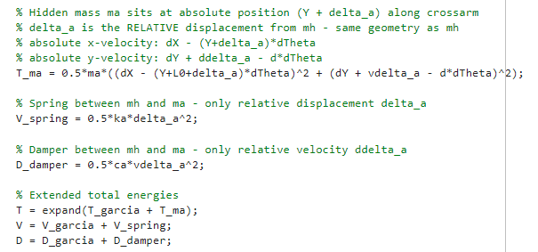
Lagrange-Euler – Additional state
Only added offset L0
Notes:
delta_a is a position - specifically the relative displacement
of the hidden mass ma with respect to the payload mh, measured along
the Y-axis (the cross-arm direction).

Slide 19
Results verified against simscape
System with MSD vs Simscape with MSD
RMSE X1 : 2.4919e-07 m
RMSE X2 : 1.6463e-07 m
RMSE Y : 5.0275e-09 m
System without MSD vs Simscape with MSD
RMSE X1 : 4.4957e-07 m
RMSE X2 : 2.9607e-07 m
RMSE Y : 7.6171e-09 m
For ASMPT it was required that the formulas for the additional state are correct

Slide 20
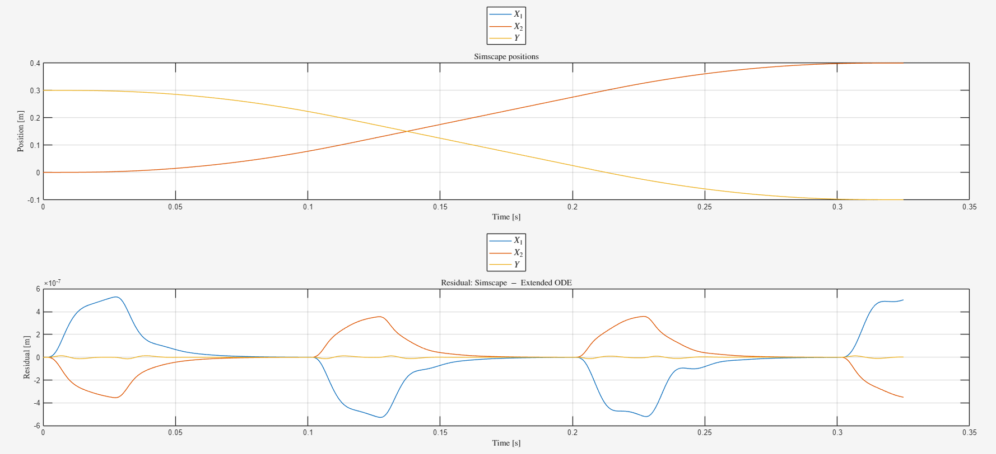

Slide 21
Additional state against simscape
Additional state delta_a (extended ODE vs Simscape)
RMSE delta_a : 2.1787e-10 m

Slide 22
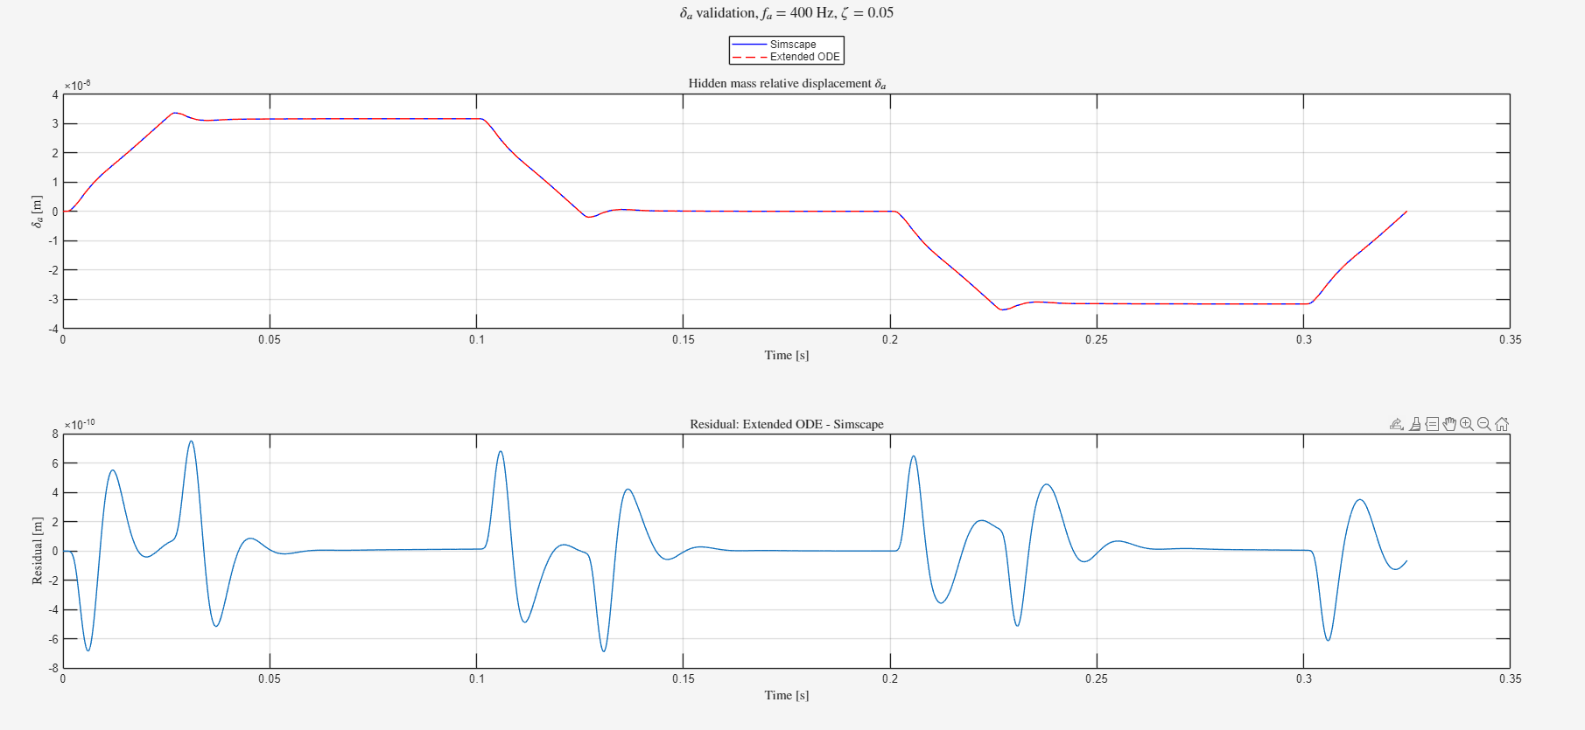

Slide 23
Both without augmenatation
=== Baseline model RMSE vs Simscape ===
RMSE X1 : 5.7487e-09 m
RMSE X2 : 4.3737e-09 m
RMSE Y : 8.8062e-10 m

Slide 24
Drenth’s JAX code for augmentation?
Or for later?
Recommended to first adapt Jan’s code to the gantry setup and adapt Roel’s code in JAX possible later?

Slide 25
Outline next week
Work on implementing Jan’s augmentation structure
  First without joint estimation → parameters of the baseline model are kept constant

Slide 27
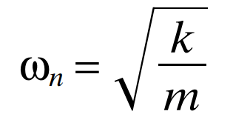
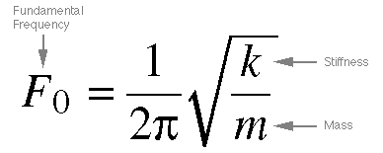
Frequency
400 hz range kijken met massa en spring stiffness → meer realistisch dan in de 27 hz range als ik die nog niet gevonden zou hebben.
Formule jasper gebruiken voor damping coefficient bepalen: Meestal percentage
Offset middelpunt zelfde maken als formules (R)
ka = 1.01 * (2π * 400)² ≈ 6.38 × 10⁶ N/m

Slide 28
Choices:
- Target frequency: f_a = 400 Hz
- Damping ratio: zeta = 0.05 (metal structures with joints, range 0.03-0.07)
Calculated:
k_a = m_a * (2pif_a)^2 = 1.01 * (2pi400)^2 ≈ 6.38e6 N/m
c_a = 2 * zeta * sqrt(k_a * m_a) = 2 * 0.05 * sqrt(6.38e6 * 1.01) ≈ 254 Ns/m

Slide 29
Determining stiffness and damping coefficient
https://www.jpe-innovations.com/precision-point/structural-damping-properties-mechanical-systems/
Formula stiffness circa 200-400 hz (choose 400) but coupled system, so will have to see how it affects.
For damping choose Metal structures with joints 0.03 - 0.07

Slide 30
Note:
Picture is not fully accurate, we define the mass as the relative displacement from mh currently
Will need to add offset

Slide 32
Question about Roel’s framework

Slide 33
Baseline model
The García-Herreros first-principles model is a rigid-body quasi-LPV model with 6 states (positions and
velocities of X1, X2, Y), 3 inputs (forces), 3 outputs (positions). It captures rigid translation,
rotation, and position-dependent inertia through M(Y), with Y as the scheduling variable.

Slide 35
Problem definition
What the baseline structurally cannot represent on the real system:
1. Flexible structural modes -- the most important unmodeled effect. The real gantry has
spring-mass-damper modes driven by the shared beam and structural compliance. These require hidden extra
states that do not exist in the 6-state rigid-body model. They are not directly observable.
2. Cross-coupling -- between X1 and X2 (via the shared beam), and between the X and Y axes. The rigid-body
model has coupling only through M(Y). The real structural coupling goes beyond this and is the primary
target for ASMPT.
3. Nonlinearities -- actuator nonlinearity, hysteresis. Secondary target.
4. Cogging and friction -- already partially handled in firmware. Not the augmentation target.

Slide 36
The shared beam couples the actuator dynamics, so motion of one actuator influences the other, and the system exhibits position-dependent behaviour and flexible dynamics
Augmentation structure What augmentation structure can effectively capture dynamics not modeled in the physics based baseline model, in particular flexible cross-coupling dynamics?

Slide 37
1. What is the baseline model
- García-Herreros FP model, quasi-LPV, rigid-body, 6 states
- Captures: rigid translation, rotation, position-dependent inertia M(Y)
- Already implemented as LPV-LFR (LFRBaselineBlock)
2. What the baseline structurally cannot capture
- Flexible structural modes: hidden states, not in rigid-body vector, cause residual oscillations at
settling
- Structural cross-coupling: shared beam couples X1, X2, Y beyond what M(Y) provides
- Position-dependent flexible dynamics: beam stiffness varies with Y, resonance frequencies shift
3. Why this matters for ASMPT
- Settling error is the industrial metric -- the FP model fails at settling precisely because the flexible
modes are absent
- Cross-coupling means one gantry disturbs the other -- not captured, directly hurts throughput
4. Which augmentation structure and why
- Dynamic: flexible modes need extra states x̃ -- they have their own time evolution
- Parallel: preserves baseline interpretability, enables orthogonal regularization
- LPV: flexible modes are position-dependent, augmentation must also vary with Y
- MIMO: cross-coupling is inherently multi-axis, cannot be decomposed
5. What makes this an open problem
- Jan's framework: augmentation but LTI only
- Drenth's framework: LPV-LFR but identification, not augmentation
- Your project: combining both -- dynamic parallel augmentation on an LPV-LFR baseline, MIMO, multiple
trajectories
6. What the augmentation will concretely learn
- Extra states x̃ representing hidden flexible cross-coupling modes
- Their Y-dependent dynamics on top of the frozen physical baseline

Slide 38
Dynamic parallel
ASMPT
Parameter identifiability
Joint estimation and Orthogonality → Dynamic
Need augmentation additional states → parallel

Slide 39
Current augmentation methods
Different methods
Benefits of different methods
Which dynamica do we want to model

Slide 40
Unmodeled dynamics
(Dual) Gantry - ASMPT
Coupling most important. See meeting notes txt files if something useful has come up
Vereisten vanuit ASMPT
  Augmentation: want to capture unmodeled dynamics, expect this to be …. And capturing the coupling is most important
  Cross-coupling between X and Y axes, and between the two gantries. Important for settling error and prediction accuracy. Currently not fully captured.
  flexible dynamics are the most important unmodeled effect.
  Nonlinearities (for example actuator not fully linear?)
  Cogging and friction are partially handled already by firmware: not the primary augmentation target.
  the flexible/structural effects are hard to model because they are strongly coupled and structurally complex. The rigid-body FP model captures translation and rotation as rigid degrees of freedom. The flexible modes require extra states (the spring-mass-damper modes) that do not exist in the rigid-body state vector — they are hidden, not directly observable.

Slide 41
Explain static and dynamic and then series and parallel for both

Slide 42
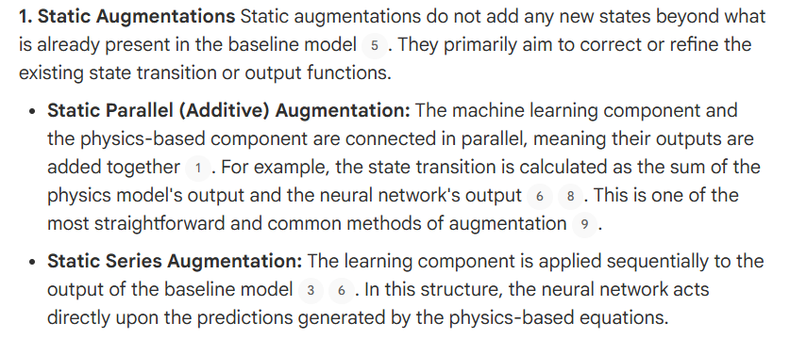
1. Static parallel: adds a correction directly to the state transition, taking the same inputs as the FP model. No extra states
2. Static series
3. Dynamic parallel
4. Dynamic series

Slide 43
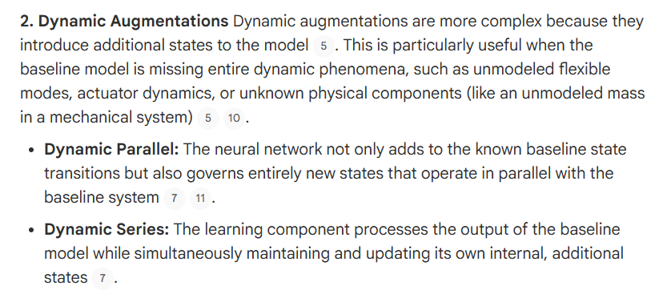

Slide 44
Orthogonality
What the orthogonality paper adds (Györök et al. 2025)
This paper focuses exclusively on static parallel / additive augmentation
The solution: orthogonal projection regularization

Slide 45
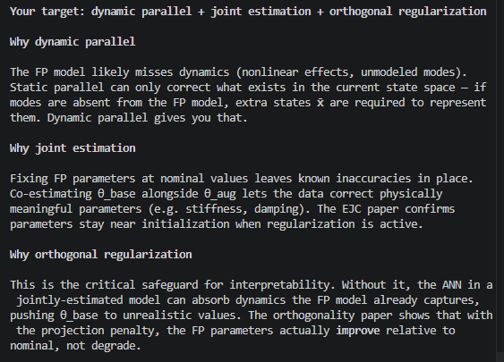
Your target: dynamic parallel + joint estimation + orthogonal regularization

Slide 46
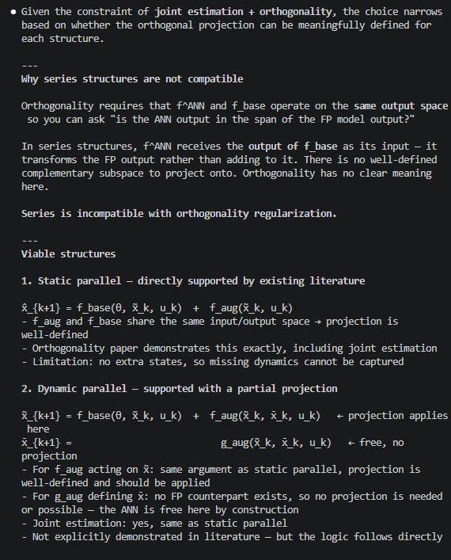

Slide 47
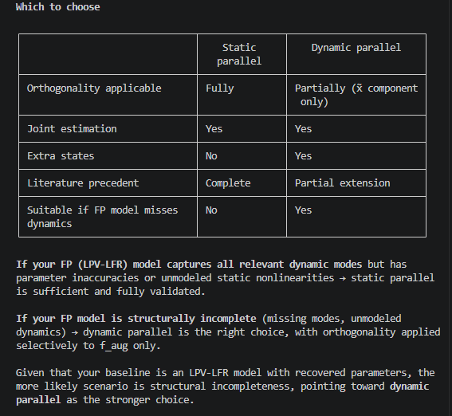

Slide 48
Augmentation
Additional state
Want it to be physically meaningful / if I add dynamics (MSD) the formulas need to be correct – ASMPT

Slide 49
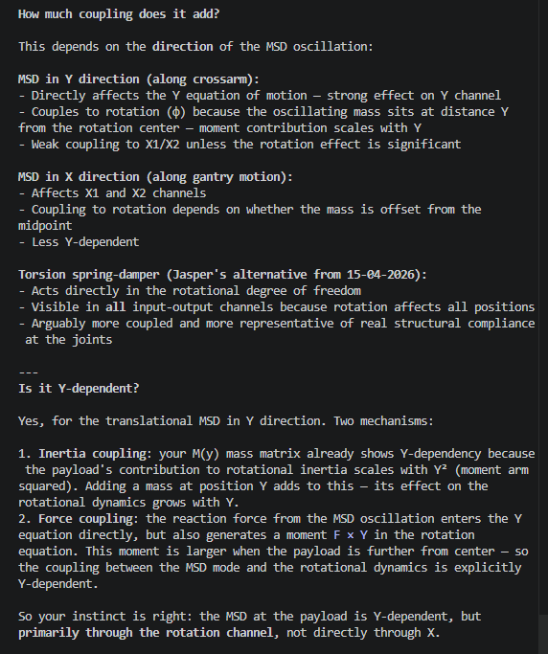
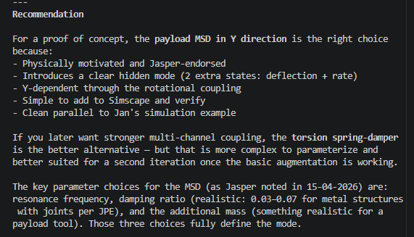
Augmentation
Additional state
o

Slide 50
Do I add the total payload mass and then the augmentation has to “find” the two masses (MSD attached)

Slide 51
Validation
Simulink
Does the augmentation show up in the FRF?:
I dont know how to classify this. I think I'll have to compare the FRFs of the two
or rms or some metric to determine whether the augmentation is valid
What does an MSD add to the dynamics? what do we expect to see in addition due to the MSD?
(- The difference should show a clear resonance bump at omega_n / (2*pi) ≈ 3.6 Hz
- If the bump is barely above the noise floor the fraction is too small)
Notes:
Why ka=500, ca=2? Is it reasonable?
These came from the context prompt (Jasper's guidance), not my own choice. The
reasoning was:
- omega_n = sqrt(ka/ma) = sqrt(500/1.01) ≈ 22.2 rad/s ≈ 3.54 Hz — places the
resonance within the setpoint bandwidth so it gets excited by the step trajectory
- zeta = ca / (2*sqrt(ka*ma)) = 2 / (2*sqrt(500*1.01)) ≈ 0.045 — within Jasper's JPE
damping range 0.03–0.07
How to frame it to supervisors: the FRF is not a research contribution — it is
evidence that the simulation PoC is a valid test. Without it, a reviewer can always
ask "how do you know the hidden dynamics were actually excited?" The FRF closes that
question.
If supervisors still push back, the counter-question is: what would they accept as
evidence that the simulation PoC is a fair test of the augmentation?

Slide 52
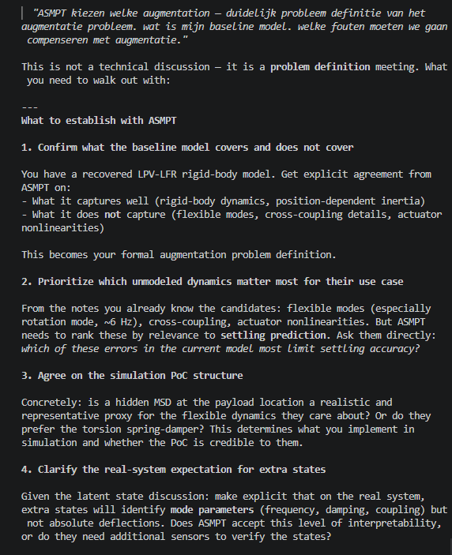
Establish with ASMPT

Slide 53
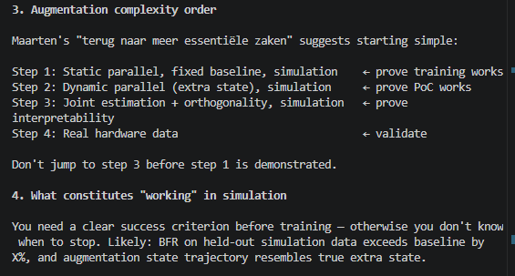
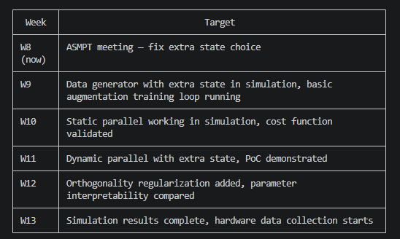
High level planning next month
Augmentation
First joint without orthogonality? Maybe first choose a simpler structure, maybe just extra work

Slide 54
Drenth’s JAX code for augmentation?
Or for later?
Maybe since JAX code is optimized preferred? Since wont have to optimize code

